Slide 1
AI Use Case

Slide 2
CASE 1
Use AI to Generate CI/CD
By Claude AI

Slide 3
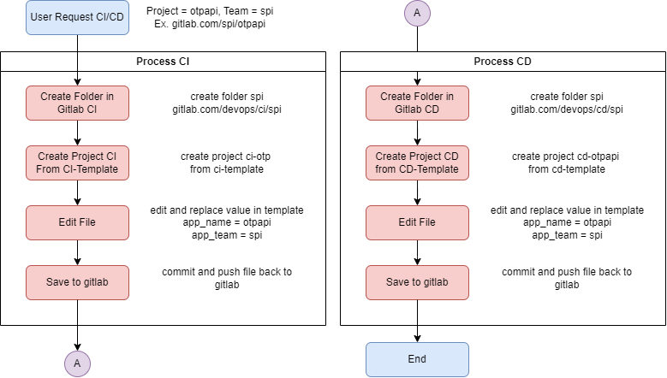

Slide 4
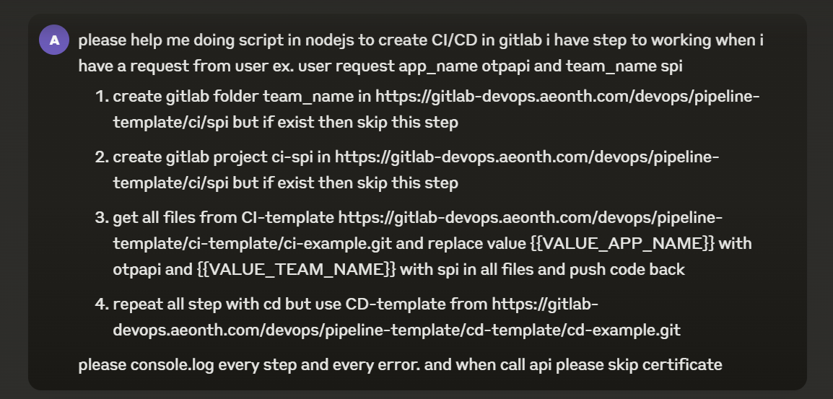

Slide 5
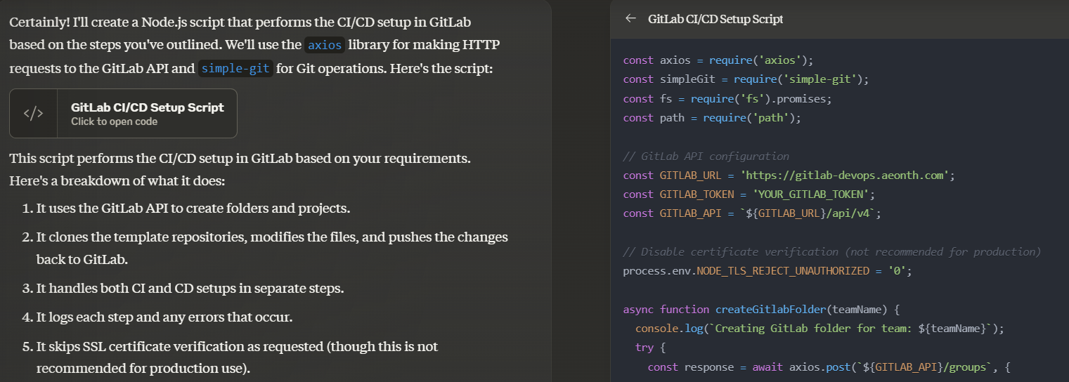

Slide 6
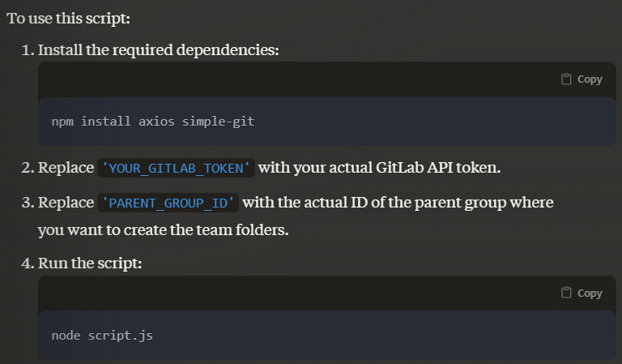

Slide 7



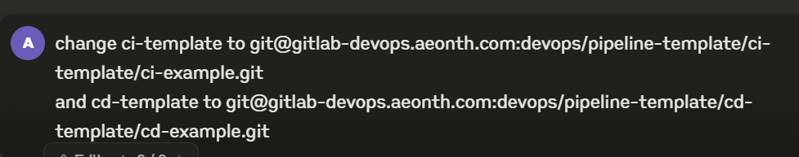

Slide 8
result

Slide 9
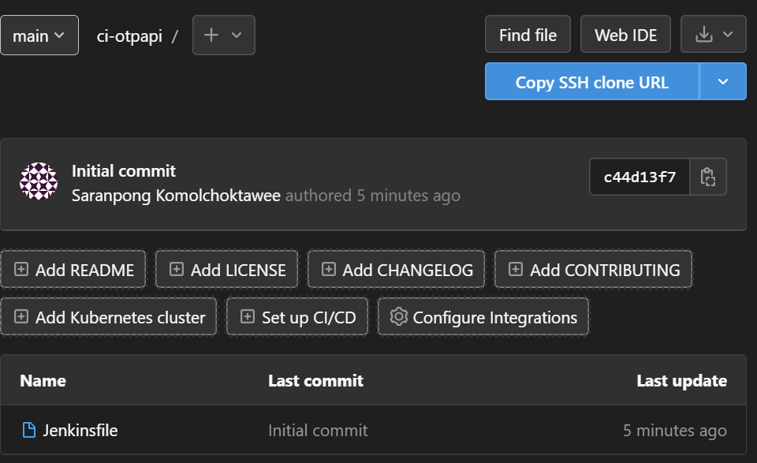
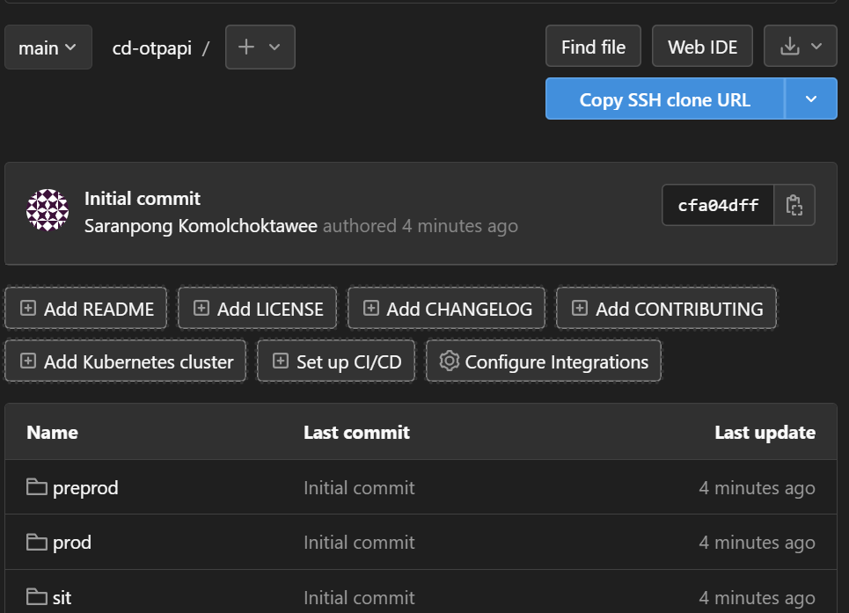

Slide 10
CASE 2
Generate Report from Jenkins
By ChatGPT

